Slide 1
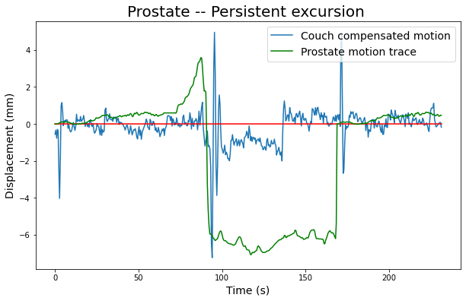
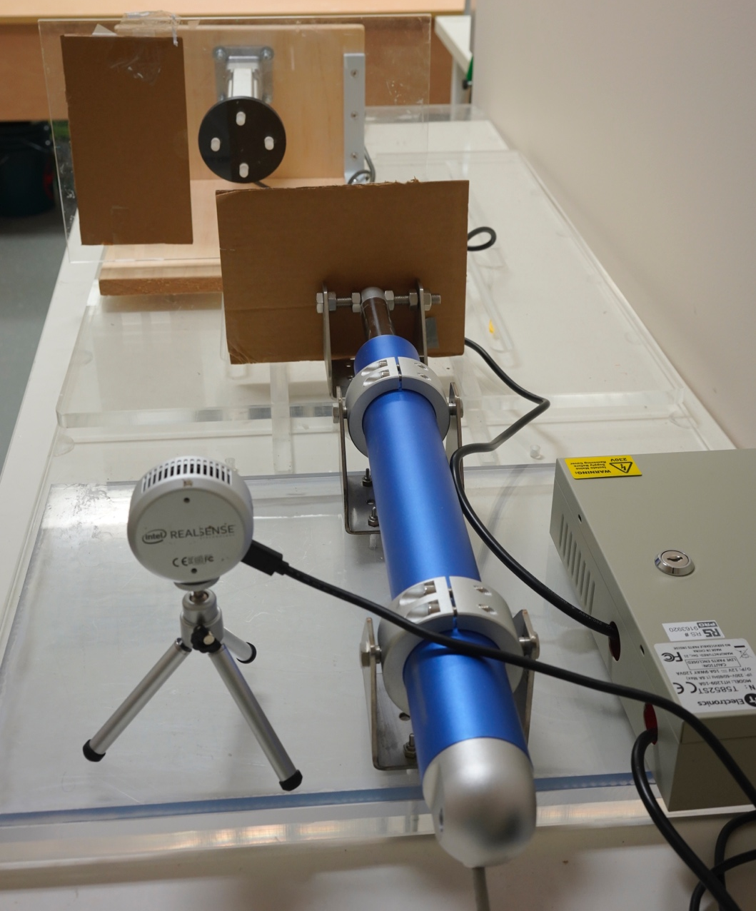
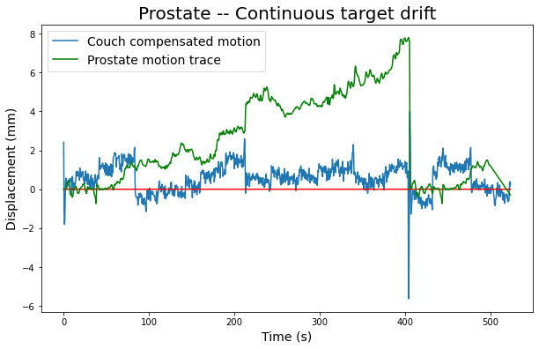
1D platform
Couch & Couch motor
RealSense depth camera
a)
b)

Slide 2

Couch Tracking Flowchart –with Intel Realsense depth camera UDPsender_realtime.py
Platform moves in 1D, based on the input trace.
Depth camera measures depth values in real-time. Write to csv file, frame number, timestamp, ROI1 depth values (1D platform), ROI2 depth values (couch)
Couch is receiving ROI1 depth values via UDP in real-time. Motor travel in opposite direction of 1D platform to achieve motion compensation.
*** For code details please see couch tracking pseudocode document.
Input Trace
1D platform
Depth camera
Couch
Frame No. Timestamp, ROI1, ROI2
Couch Motor

Slide 3
Couch Tracking with pre-recorded trace Flowchart – UDPsend_trace.py
UDP sender
Input Trace
Depth camera
Couch
Depth camera
Frame No. Timestamp, ROI1, ROI2
1D platform
Frame No. Timestamp, ROI1, ROI2
Couch Motor

Slide 4
Intel RealSense depth camera
(Surface tracking)
KIM
(Internal motion tracking)
Other methodologies…
Couch Compensation

Slide 5
Isocenter
Target motion range
Compensated motion range
Tracking Target
(6Dof Robotic arm/
1D motion platform)
Tracking Tool
(KIM/
Depth measurement)
Target being tracked,
Positional measurement generated
Measurements are sent to couch via UDP
Movable Couch

Slide 6
Elekta/Varian kV imager
KIM
(Generated measurements)
kV images in real-time
Ethernet connection
Track internal motion
Router
Ethernet connection
6 degree-of-freedom
robotic arm
Motor power supply
Phantom
Integrated Raspberry Pi & DC motor drive
Linear actuator motor
Couch
USB Connection
Clinical experiment hardware setup
Monitor
Keyboard & Mouse
Router establishes private UDP communication with pre-set fixed IP address
Robotic arm moves phantom to simulate patient internal motion
Phantom positions are tracked by kV imager, measurements are generated by KIM algorithm
Pi receives measurements and operate couch to perform motion compensation

Slide 7
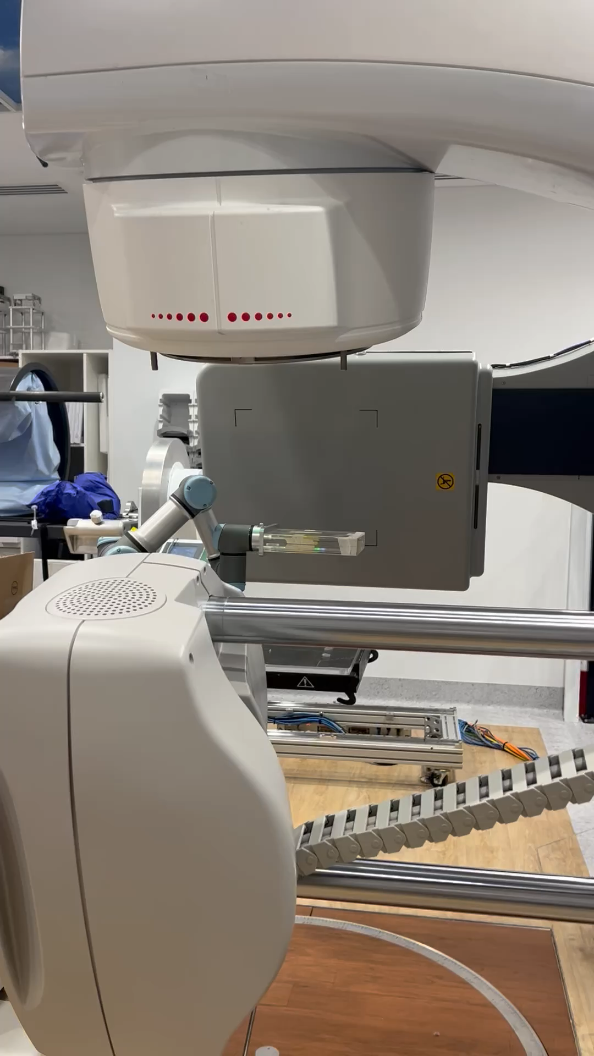

Slide 8
Intel RealSense Depth Measurement
Track surface motion
Ethernet connection
Router
Ethernet connection
6 degree-of-freedom
robotic arm
Motor power supply
Phantom
Integrated Raspberry Pi & DC motor drive
Linear actuator motor
Couch
USB Connection
Laboratory experiment hardware setup
Monitor
Keyboard & Mouse
Router establishes private UDP communication with pre-set fixed IP address.
Robotic arm moves phantom to simulate patient internal motion.
Phantom surface positions are tracked by depth camera.
Pi receives measurements and operate couch to perform motion compensation.

Slide 9
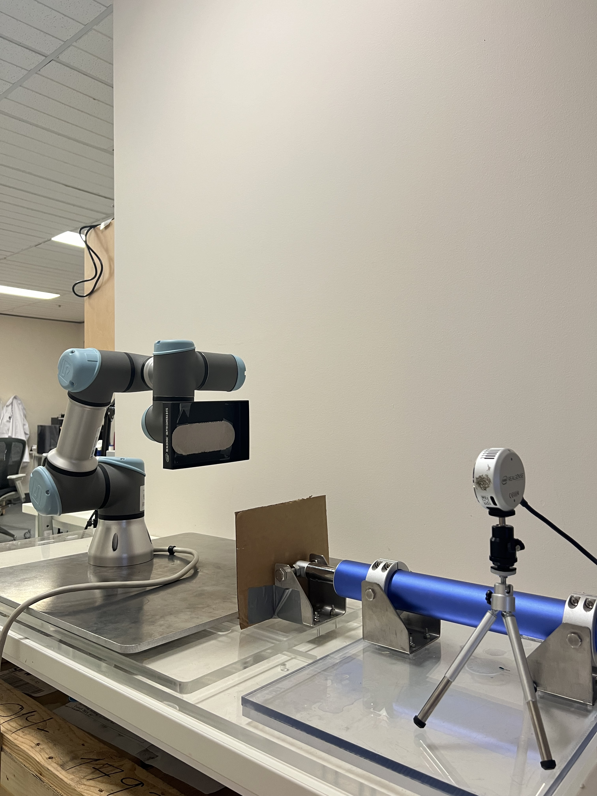
Robotic arm to replicate target motion
Intel Realsense depth camera
Linear actuator motor
Couch

Slide 10
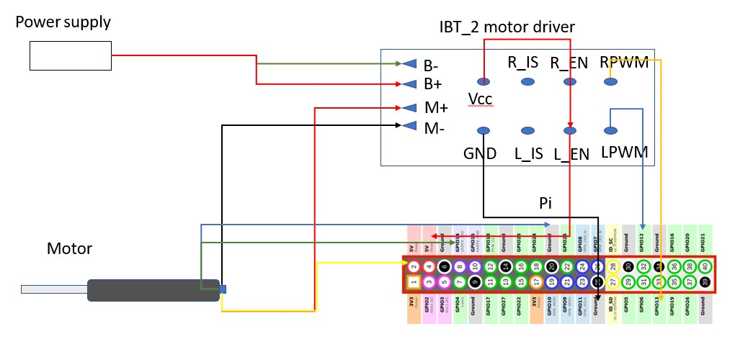
Raspberry Pi connection

Slide 11
Target Tracking
KIM + Couch emulator
Couch
Input motion trace
UDP receive
Couch Feedback
Compensation algorithm
Updated positions
Couch move
KIM noise
Couch error
Couch positions
KIM latency
Motion plot in real-time
UDP send

Slide 12
Couch Compensation – Always compensate on latest measurement
Target tracking
Couch response
Frame No. Timestamp, ROI1, ROI2
Couch moving
Frame No. Timestamp, ROI1, ROI2
Frame No. Timestamp, ROI1, ROI2
Frame No. Timestamp, ROI1, ROI2
Couch moving
Frame No. Timestamp, ROI1, ROI2
Frame No. Timestamp, ROI1, ROI2
Frame No. Timestamp, ROI1, ROI2
Frame No. Timestamp, ROI1, ROI2
Couch moving

